Slide 1
Deep Learning-Based Microplastic Detection in Water
An Innovative Approach for Environmental Monitoring

Slide 2
Project Guide and Members
Project Guide:
Dr. K Devi Priya
(Associate Professor)
Team Members:
Pabbisetty Tomala Durga Sai Ram (21761A0542)
Karra Leela Sasank (21761A0530)
Abdul Shafi (21761A0501)

Slide 3
Abstract
Microplastics are one of the major pollutant issues in the aquatic zone. Microplastics are required to be identified in the water and needed to take preventive measures in order to eliminate them, because they have become the major source of different problems like ecosystem disruption, water pollution, respiratory and endocrine system diseases. Major analytical techniques used to detect microplastics are Fourier-Transform Infrared Spectroscopy and Raman Spectroscopy. These analytical procedures of detecting microplastics approximately less than 5 millimeters can be replaced using different deep learning techniques. These techniques will be more accurate in detection of microplastics, with proper model training and building.

Slide 4
How Microplastics Detection is Useful
Environmental Protection: Detecting microplastics helps identify pollution hotspots and mitigate the harm they cause to marine life and ecosystems.
Human Health: Detection is essential for understanding how microplastics enter the food chain and assessing potential health risks associated with their ingestion.
Policy and Regulation: Microplastics detection provides critical data for policymakers to create effective environmental regulations and ensure compliance.
Scientific Research: Detection enables scientists to study the sources, pathways, and long-term impacts of microplastics on ecosystems and human health.
Economic Impact: Early detection supports industries like fisheries and tourism by preventing economic losses and reducing cleanup costs.

Slide 5
Literature survey
Author | Title | Year | Methodolgy | Dataset | Result
Joana Correia Prata, João P. da Costa, Armando C. Duarte, Teresa Rocha- Santos | Methods for sampling and detection of microplastics in water and sediment: A critical review | 2019 | Review of methods for sampling and detecting microplastics in water and sediment. | No specific dataset used. | Earth's ecosystems are contaminated with microplastics.
Albert A. Koelmans, Nur Hazimah Mohamed Nor, Enya Hermsen, Merel Kooi, Svenja M. Mintenig, Jennifer De France | Microplastics in freshwaters and drinking water: Critical review and assessment of data quality | 2019 | Review of fifty studies on microplastics in drinking water, highlighting need for standard methods. | Data from fifty studies on microplastics in various water sources, including drinking water and wastewater. | Microplastics are frequently present in water sources; quality assurance in sampling and analysis is needed.

Slide 6
Author | Title | Year | Methodolgy | Dataset | Result
Thunchanok Thammasanya, SakaratPatiam, Eknarin Rodcharoen & Ponlachart Chotikarn | A new approach to classifying polymer type of microplastics based on Faster‑RCNN‑FPN and spectroscopic imagery under ultraviolet light | 2024 | This study presents a novel method combining UV light and deep learning (Faster-RCNN with ResNet-50-FPN) to detect and classify microplastics. Field images taken under UV light were used to train and validate the model. | Samples were collected from 8 stations around “Koh Yo island“ | Achieved 85.5–87.8% precision, with mAP scores of 33.9% on an internal test set and 35.7% on an external test set, providing a high-accuracy, low-cost, and time-effective solution.
Hui Huanga, HuiwenCaic, Junaid Ullah Qureshi | Proceeding the categorization of microplastics through deep learning-based image segmentation | 2023 | This study presents an automated technique for identifying microplastics (MPs) using a Deep convolutional neural network (DCNN) and Mask R-CNN for segmentation and shape classification. The model was trained with diverse MP images, and erosion and dilation operations were added to improve results. | Micro Plastic samples from beach sediments & water | Achieved mean F1-scores of 0.7601 for segmentation and 0.617 for shape classification, demonstrating the method's potential for automatic MP identification and standardization.
Bin Shia, Medhavi Patel, Dian Yu | Automatic quantification and classification of microplastics in scanning electron micrographs via deep learning | 2022 | This study uses scanning electron microscopy and deep learning (U-Net and MultiResUNet) for microplastics quantification and VGG16 for shape classification. Manual annotation of 237 micrographs was used for training. | Water bodies, laundry water samples | Achieved high average Jaccard index over 0.75 for segmentation, and 98.33% accuracy for shape classification. Models provide fast and accurate results.
Vittorio Bianco, Pasquale Memmolo, Pierluigi Carcagnì | Microplastic Identification via Holographic Imaging and Machine Learning | 2020 | This study combines 3D coherent imaging and machine learning (ML) to detect microplastics (MPs) in filtered water samples. The approach uses "holographic features" to distinguish MPs from marine microalgae. |  | Achieved over 99% accuracy in classifying thousands of items, effectively identifying MPs regardless of morphology, size, or plastic type.
JAVIER LORENZO-NAVARRO, MODESTO CASTRILLÓN-SANTANA | SMACC: A System for Microplastics Automatic Counting and Classification | 2020 | This study presents a Computer Vision-based system to automatically count and classify microplastic particles (1-5 mm) into five visual classes. The system uses images, Sauvola thresholding for segmentation, and various classifiers. | Manual collection of samples from water bodies | Tested on 12 beach samples with 2507 particles, achieving a 1.4% difference in count and less than 4% classification error, in less than half the time of manual counting.

Slide 7
Author | Title | Year | Methodolgy | Dataset | Result
Yinlong Luo, Wei Su , Xiaobin Xu , Dewen Xu | Raman Spectroscopy and Machine Learning for Microplastics Identification and Classification in Water Environments | 2023 | Using Raman spectroscopy combined with a sparse autoencoder and softmax classifier, this study achieved 99.1% accuracy in rapidly identifying and classifying six types of microplastics in various water environments, outperforming traditional machine learning methods. | The dataset for this study was collected from various water environments, including pure water, tap water, rain water, lake water, and sea water. | This study developed a rapid method for identifying and classifying microplastics (PET, PP, PS, PVC, PE, PC) in various water types, achieving 99.1% accuracy using Raman spectroscopy combined with machine learning algorithms, significantly outperforming SVM and BP neural networks.
Oleksandr Malyuskin | Microplastic Detection in Soil and Water Using Resonance Microwave Spectroscopy: A Feasibility Study | 2023 | A feasibility study shows that resonance microwave reflectometry can detect and quantify microplastics in soil and water at around 100 ppm resolution, offering a cost-effective, real-time alternative to traditional spectroscopic methods. | The dataset for this study was collected using artificially created samples of microplastic-contaminated s water with precisely controlled high-level contamination. | Experimental data show that microplastics were detected and both fresh and salty water, with samples artificially contaminated at tens to hundreds of parts-per-thousand (ppt) levels for precise control.
Chakraborty, N Mazumder, . Noothalapati | Raman spectroscopy for microplastic detection in water sources: a systematic review | 2022 | Raman spectroscopy identifies common microplastics such as polystyrene, polyethylene terephthalate, polyethylene, and polypropylene in various water sources, highlighting their environmental impact and sources. | sources were collected from the Scopus and Web of Science (WOS) databases. | Raman spectroscopy effectively detects and characterizes microplastics in various water sources, overcoming traditional method limitations and enabling real-time, portable, and sensitive analysis.
Veronica Nava, Maria Frezzotti, Barbara Leoni | Raman Spectroscopy for the Analysis of Microplastics in Aquatic Systems | 2021 | Raman spectroscopy effectively analyzes microplastics in aquatic systems, aided by resources like a catalog of Raman peaks and the RamanMP R package, despite challenges like fluorescence interference and weathered polymer analysis. | includes a database of 356 spectra, 325 of which are additives. | Provides a comprehensive catalog of Raman peaks for common plastic polymers and additives, and introduces the “RamanMP” R package with 356 spectra to enhance the technique’s application in microplastic analysis.

Slide 8
Limitations
Data Collection (Inadequate Data): Difficulty in obtaining high-quality, diverse images of microplastics, leading to potential data gaps and analysis challenges.
Image Pre-Processing: Variability and artifacts in image capture and pre-processing can affect the quality and consistency of the analysis.
Complex Procedures: Manual and complex procedures can introduce errors and require significant time and effort.
Real-Time Analysis: High computational demands can hinder real-time processing and analysis efficiency.
Diverse Classification: Difficulty in accurately classifying varied microplastics types and sizes due to their diversity and complexity.
Cost and Equipment Requirements: Expensive equipment and resources limit accessibility and scalability of detection efforts.

Slide 9
Why Deep Learning ?
Scalability and Efficiency: Deep learning models can efficiently process large volumes of water sample data, facilitating rapid and scalable microplastic detection.
Accuracy and Consistency: Properly trained deep learning techniques provide high accuracy and consistency in identifying microplastics, reducing human error and variability.
Detection of Small and Complex Features: Deep learning algorithms excel at recognizing intricate patterns, enabling the detection of small and complex microplastic particles.
Automation and Throughput: Deep learning allows for automated microplastic detection, significantly increasing throughput and providing real-time monitoring.
Reduced Cost: Once deployed, deep learning systems can be more cost-effective than traditional methods due to reduced manual labor and fewer high-cost instruments.
Enhanced Data Analysis: Deep learning models offer detailed insights into microplastic characteristics, aiding in comprehensive data analysis and mitigation strategies.

Slide 10
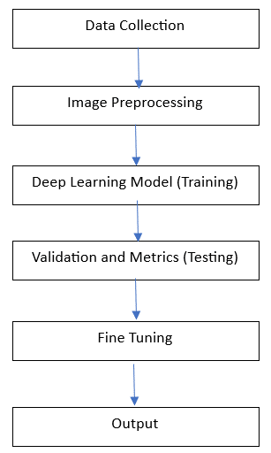
Proposed Architecture

Slide 11
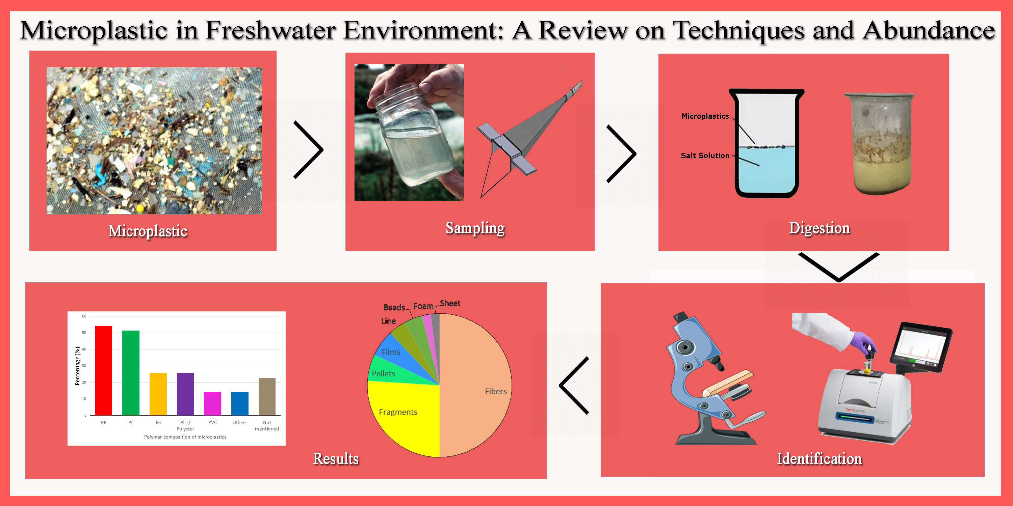
Data Collection and Preprocessing

Slide 12
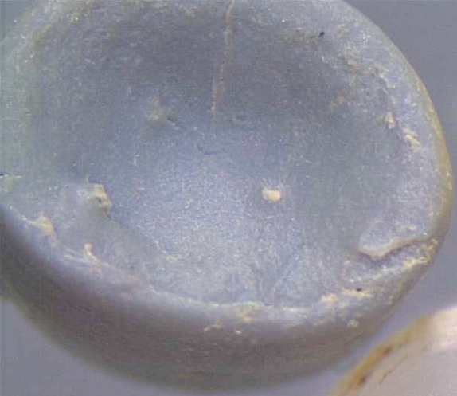
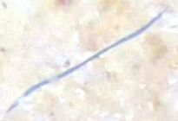
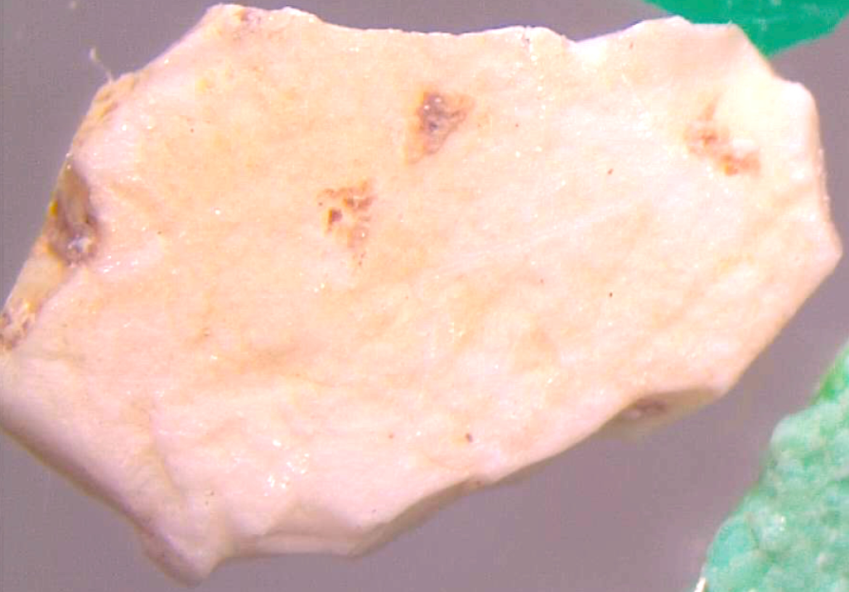
Microscopic Images of Microplastics (Bead, Fragment & Fiber)
Bead
Fiber
Fragment

Slide 13
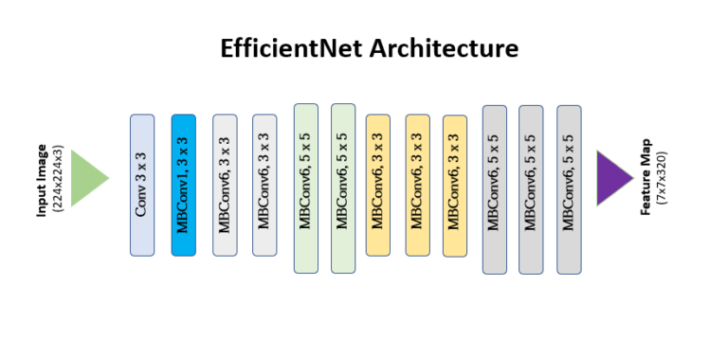
Deep Learning Models
EfficientNetB7 Model
EfficientNet models (B0 to B7) use compound scaling to progressively increase depth, width, and resolution, offering a balance between model size, computational cost, and performance. EfficientNet-B0 is the baseline, while B1 to B7 are progressively larger. EfficientNet-Lite variants are optimized for mobile and edge devices, focusing on efficiency and performance.

Slide 14
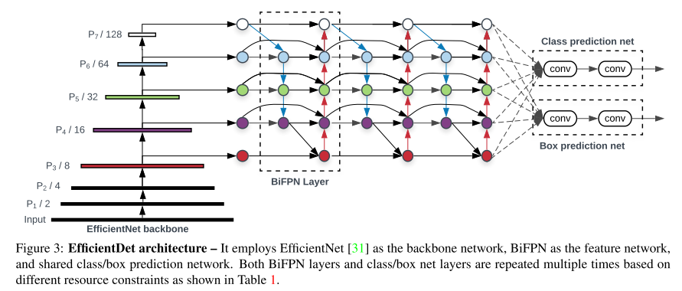
EfficientDet Model
EfficientDet is an object detection model that balances accuracy and efficiency by leveraging the EfficientNet backbone. It uses a BiFPN (Bidirectional Feature Pyramid Network) for effective multi-scale feature fusion, enhancing the model’s ability to detect objects of various sizes. EfficientDet is designed for optimal performance with reduced computational costs, making it suitable for applications requiring both high accuracy and efficiency.

Slide 15
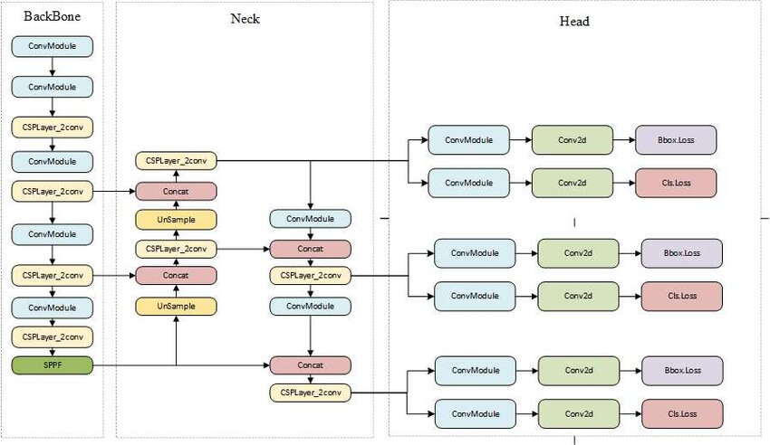
YoloV8 Model
YOLOv8 is the latest YOLO model for real-time object detection, featuring an advanced backbone for better feature extraction and improved detection heads. It balances high speed with accuracy, efficiently detecting objects of all sizes. The model enhances performance through optimized processing and advanced multi-scale feature fusion.

Slide 16
Model Evaluation (Testing)
Test Set Evaluation: Evaluate on a separate test set.
Performance Metrics:
Accuracy: Overall accuracy on test set.
Confusion Matrix: To visualize true/false positives and negatives.
Output: Test accuracy and confusion matrix.
Detection and Visualization
Prediction: Using trained model to classify new images.
Visualization:
Prediction Results: Display image with predicted label.
Prediction Probabilities: Show probabilities for each class.
Output: Visualized results and detected microplastic classes.

Slide 17
Conclusion
In this project, we are working towards developing a robust system for detecting microplastics in water using advanced deep learning models. Our approach is to achieve a balance between accuracy and efficiency, focusing on real-time detection and effective multi-scale feature fusion. We are incorporating advanced image pre-processing and fine-tuning strategies to optimize model performance while leveraging the models' built-in feature extraction capabilities. The goal is to enhance the identification of microplastics, contributing to environmental monitoring and water quality assessment. Moving forward, we plan to complete the project by further optimizing the system and scaling it to handle diverse environmental conditions, with an emphasis on real-time analysis and comprehensive reporting.

Slide 18
THANK YOU

